Slide 1
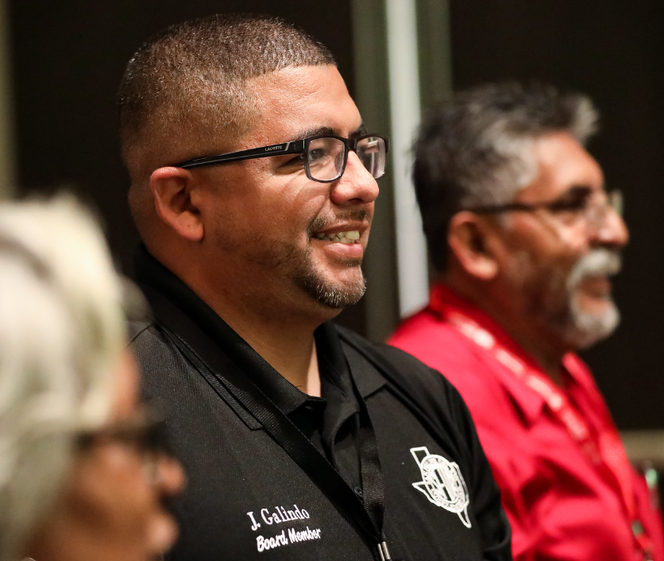

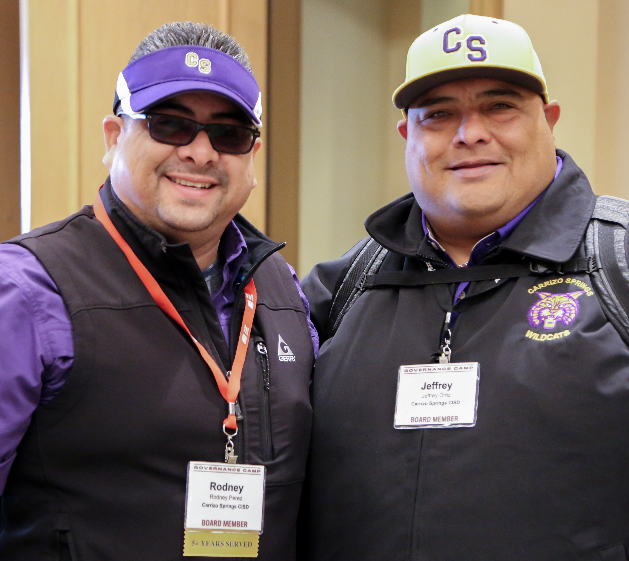



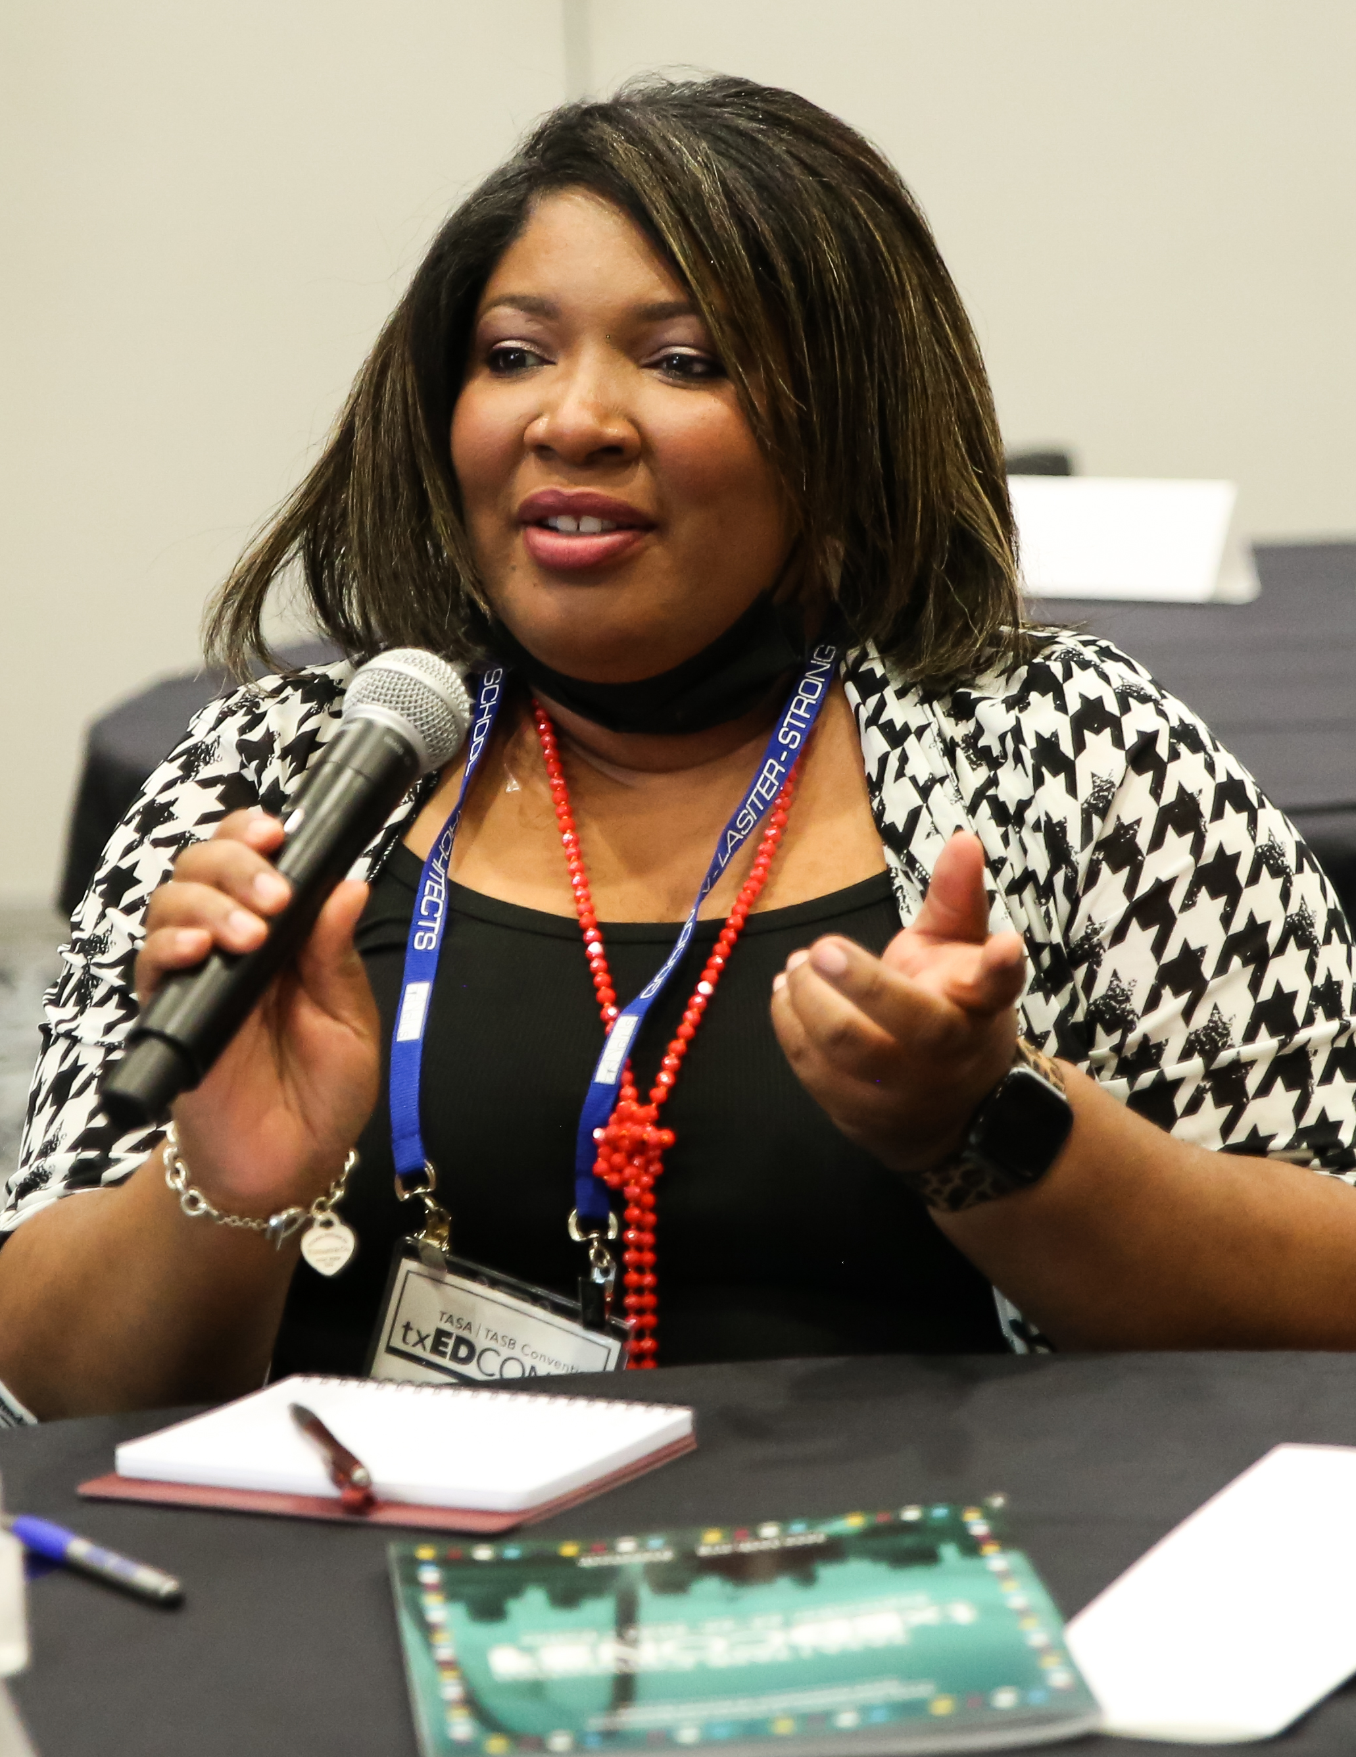
1
TASB
Who we are. Why we serve.

Slide 2



Our time together
2
About TASB
Who We Are
Member Led
How We Are Governed
4 Key Roles
for Trustees

Slide 3
Who we are
3
ABOUT TASB

Slide 4
TASB is…
4
ABOUT TASB
A private, nonprofit Texas corporation
Tax exempt under IRS 501(c)(3)
TASB is not…
A federal, state, or local governmental entity
An association of individuals
Notes:
A federal, state, or local governmental entity.
An association of individuals.

Slide 5
True North
5
ABOUT TASB
TASB is a member association of Texas school boards and education service center boards.
Active members have voting and governance privileges.

Slide 6
TASB mission
6
ABOUT TASB
Promote educational excellence for Texas schoolchildren through advocacy, visionary leadership, and high-quality services to school districts.

Slide 7
We Are:
7
ABOUT TASB
Designed to lessen the burdens of government
Dedicated to promoting and supporting public education
Committed to the longstanding tradition of nonpartisan school boards
Governed by our elected Board of Directors through a democratic and grassroots process

Slide 8
How we Are
Governed
8
MEMBER LED

Slide 9

Delegate Assembly
9
MEMBER LED
Delegate Assembly is the highest level of TASB’s governance structure.
The Assembly meets annually.
Delegates adopt bylaws and the TASB Advocacy Agenda, elect Directors, and hear reports on TASB activities.
Each Active Member board selects a Delegate to represent them at the Assembly.

Slide 10

Delegate Assembly
10
MEMBER LED
Save the date:
2025 Delegate Assembly, Saturday, Sept. 13, in Houston
Put on your board agenda in May or June
Select your Delegate and Alternate
Register your representatives in July

Slide 11
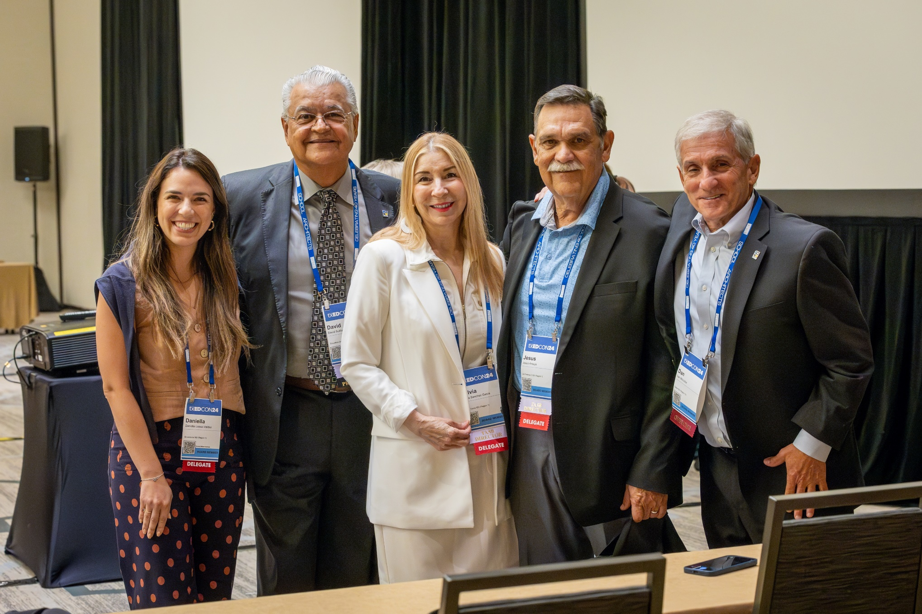
TASB Board
11
MEMBER LED
43 positions, including 6 officers
Elected to 3-year terms, with maximum of 4 full terms
Bylaws: “Supervise, control, and direct affairs of TASB”
Hold at least four meetings annually

Slide 12
What Trustees do
12
4 KEY ROLES

Slide 13
The School Board: PolicyMakers
13
KEY ROLES
“The trustees as a body corporate have the exclusive power and duty to govern and oversee the management of the public schools of the district.” Education Code 11.151(b)
Governance: The act of making decisions that provide direction, define expectations, grant power and authority, and evaluate outcomes.
Policies are the mandates, authorizations, and legally required choices necessary for the district to operate.

Slide 14
The School Board: PolicyMakers
14
KEY ROLES
Things to think about when evaluating policy recommendations:
Relevance and timing
Alignment with district goals
Resources needed for implementation

Slide 15
Resources
15
KEY ROLES
Policy Review Session
Policy Service Consulting
Make sure your board policies align with district practices.
Get guidance based on
your district’s unique characteristics and needs.
Policy Reference Manual
Legal Telephone Consultation
Stay on top of current laws governing Texas schools.
Talk to TASB attorneys about a wide range of school law issues.
The School Board: Policymakers

Slide 16
THE School BOARD: Supporting Staff
16
KEY ROLES
The interaction between HR staff and school board members should be more than just closed-session discussions about employee relations issues.
Know the policies
Know staffing strengths and challenges
Know what staff think

Slide 17
Resources
17
HR Services Surveys
Staffing
Reviews
Get statewide insights into data on salaries, benefits and leave, vacancies, and more.
Examine current staffing practices to maximize resources.
Compensation Services
Design market-based plans to improve pay practices.
The School Board: Supporting Staff

Slide 18
The School Board: Working as a Team
18
KEY ROLES
Working well as a team has a meaningful impact on student outcomes.
High-functioning board teams saw 1-4% increases in students’ reading and math scores.
Board conflicts may distract from governance responsibilities and lower student outcomes.

Slide 19
The School Board: Working as a Team
19
KEY ROLES
Unity
Unanimity
Unified
Uniform
Board Focus and Unity of Purpose = Kids Win

Slide 20
Resources
20
KEY ROLES
Transitions & Teambuilding
Goal Setting & Strategic Planning
Welcome new trustee(s) or superintendent to the new team.
Anchor board decisions with your district’s goals.
Board Self-Assessment
Board Operating Procedures
Allow time for continuous improvement and reflection.
Define your board’s culture and clarify how you conduct business.
The School Board: Working as a Team

Slide 21
The School Board: Advocating for Public Ed
21
KEY ROLES
IV. Advocacy and Engagement
The board promotes the vision and engages the community in developing and fulfilling the vision. The board advocates on behalf of Texas public schoolchildren.
Framework for School Board Development

Slide 22
The School Board: Advocating for Public Ed
22
KEY ROLES
Legislative Advocacy
The operation of responsible democratic government requires that the people be afforded the fullest opportunity to petition their government for the redress of grievances and to express freely their opinions on legislation, pending executive actions, and current issues to individual members of the legislature, legislative committees, state agencies, and members of the executive branch.
Tex. Gov’t Code § 305.001

Slide 23
Resources
23
KEY ROLES
TASB Advocacy Agenda
School Board Advocacy Network
Help build the Advocacy Agenda — the priorities taken to the Capitol.
Join SBAN to be informed on legislation and be ready to speak on issues.
Toolkit for Community Advocacy
Access TASB’s innovative step-by-step guide to building community support for public ed.
The School Board: Advocating for Public Ed

Slide 24
24
Questions?

Slide 25
25
Final Thoughts
Thank you for your time today!

Slide 26
A visit from TASB Leadership: How TASB's services elevate your Board's work
Spring Workshop - Canyon - 2025
5/21/2025
1:30 PM - 2:30 PM
CEC 9538
You must report credit within 24 hours.
Visit tasb.org/mycec and log in using TASB login.

